Slide 1
Embedded
Class #5 – Code walk through

Slide 2
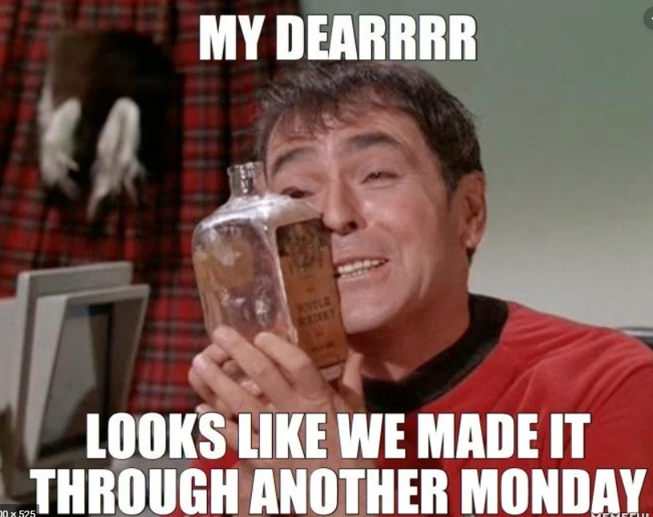
Agenda
School is Wrong
Cost of Code
What is good firmware
What is bad firmware
Firmware Review Process

Slide 3
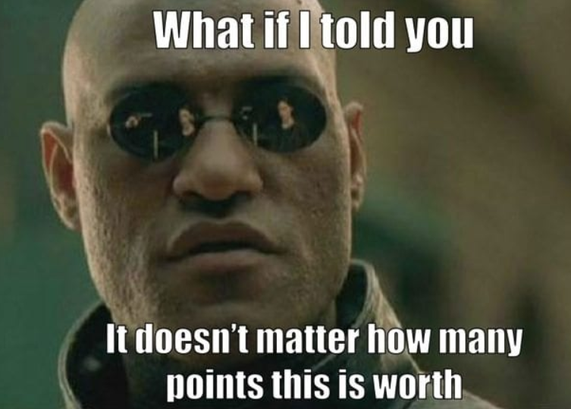
School is wrong
Hard problems are worth more points
Not always true in the real world, sometimes easy problems are worth most money.
Can not copy someone else’s work
Not true in the real world, it is often better to copy others (if license agreement allows)
Must do your own work
Not true, you are allowed to get help from friends, colleges, etc.

Slide 4
Cost of Code
One poor metric in software is lines of code (LOC)
This is a poor metric but is a metric
Estimate is that code cost is around $20-$40 per LOC.
“The Space Shuttle code cost $1000/LOC. Now, this was the best code ever written, with but a single bug per 400,000 lines of code.”
Toyota has the coveted "most expensive code every written" award. Their engine control code caused the Feds to hit them with a $1.2 billion fine, which works out to over $1200/LOC, even before one includes the actual engineering.
Fine was actually for hiding the true causes of failures.

Slide 5
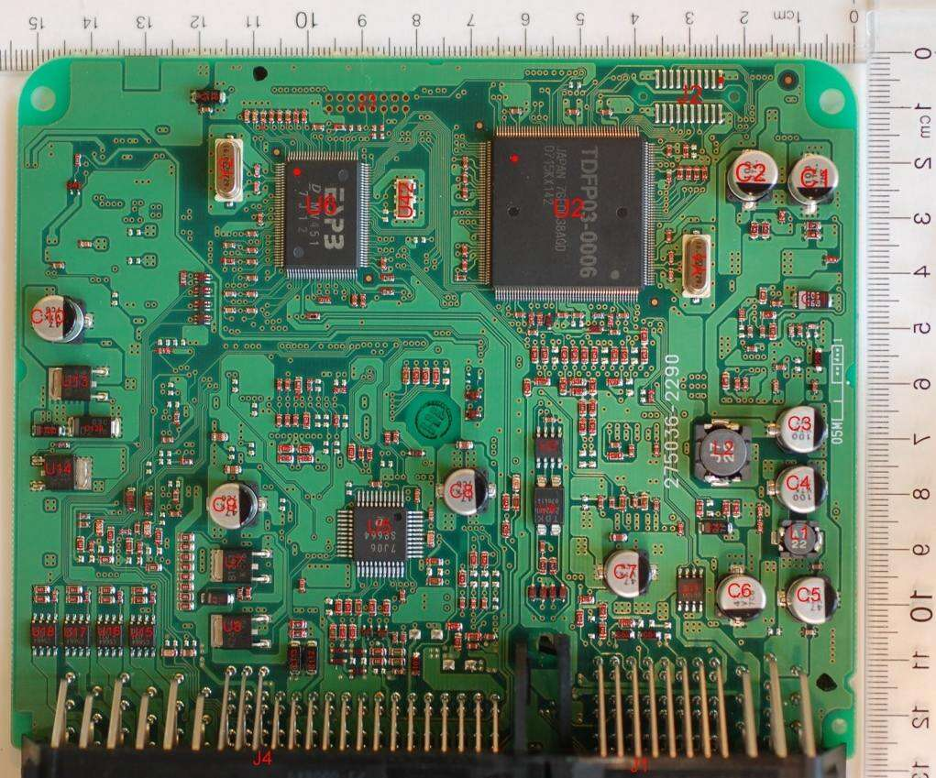
Toyota Unintended Acceleration (UA)
https://www.edn.com/design/automotive/4423428/Toyota-s-killer-firmware--Bad-design-and-its-consequences
Toyota estimated 41% of stack used
Barr showed 94% used
Code had recursive calls which could kill stack
No memory protection
No run time stack measurement
A litany of other faults were found in the code, including buffer overflow, unsafe casting, and race conditions between tasks.
“It was also found that most RTOS error codes indicating problems with tasks were simply ignored – a definite MISRA-C violation.”
Watchdog not implemented correctly…
And you are on the road with cars that have code like this…

Slide 6
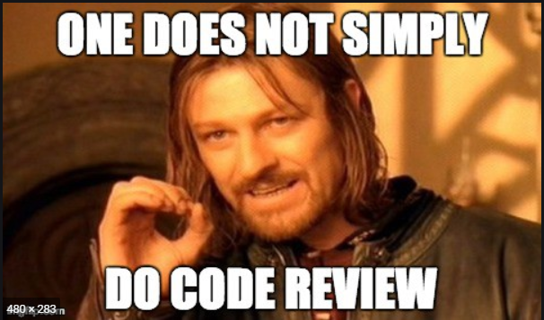
What is Bad Firmware?
Let’s go around the table…

Slide 7
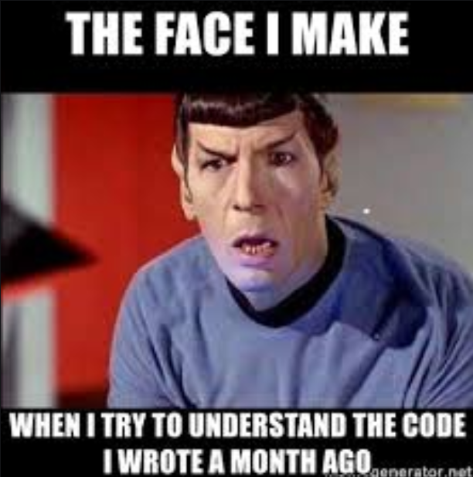
Where to Start?
So you ready to review code?
No you are not!
What are the requirements?
Where is the software manual?
What version of compiler and tools are used?
NASA had 30 volumes for their software specs
That is 40,000 pages

Slide 8
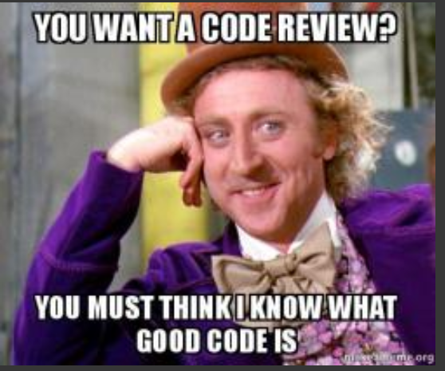
What is Good Firmware?
Operates per requirements?
Easy to understand?
Well documented?
Bug free?
Functions with no side effects?
Functions do one thing and one thing only…
Others?

Slide 9
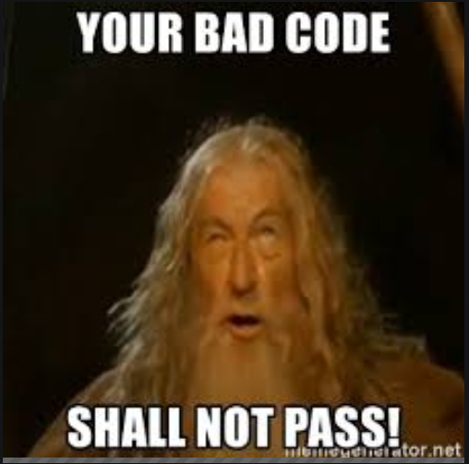
Firmware Review Process
Do you have requirements?
Does the firmware have documentation (compiler version, etc)
Is firmware checked in?
If not, then recommend checking in first.
Does firmware track stack usage?
Does it use Heap?
Can code be reused?
Does it have bug tracking?
Global variables?

Slide 10

Firmware Review Process
No matter how bad the code is…
You will at some point write worse code
You will ship worse code!
Goal is not to insult developer, the code is it’s own entity talk about the code!
Use words like “I feel” and “I think”
Avoid words that imply fault, “you”
Goal is to review code, not programmer!
You will often ask “What was the programmer thinking”
When you write code, make sure no one has to ask that…

Slide 11
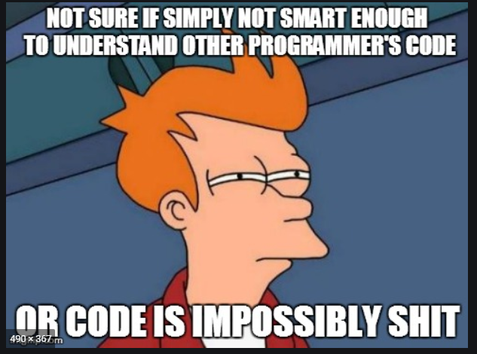
Understanding Code
One line at a time…
Figure out one line at a time and move from there…
If you are not smart enough to understand the code…
Than who is?
Most likely the author was not either.

Slide 12
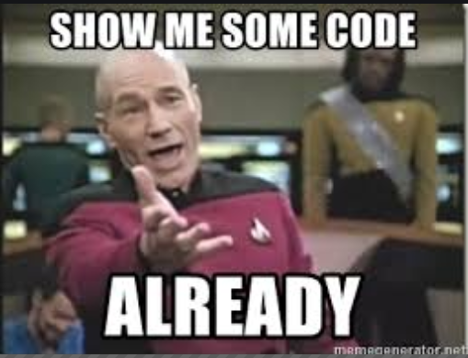
Code Walk Through
Lets open editor and look at the code

Slide 13
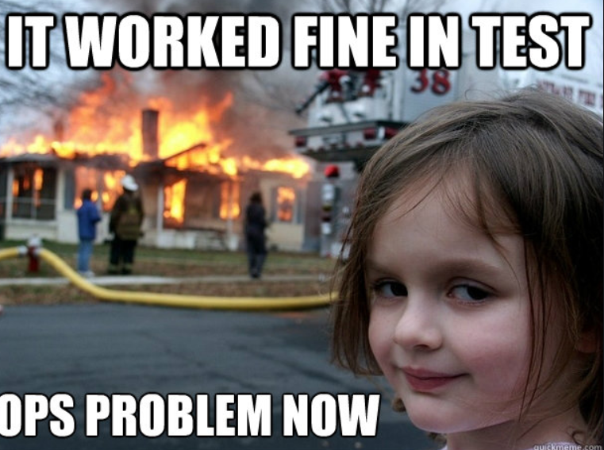
Firmware
Writing code is like building a house.
You do not want to be on the roof when you realize the foundation is crumbling.
Architect the design.
Make a foundation where you can report errors.
Build on stable foundation
No matter how many coats of paint you add to the house, it will still crumble with a bad foundation.
Learn from others (the good and the bad)

Slide 14
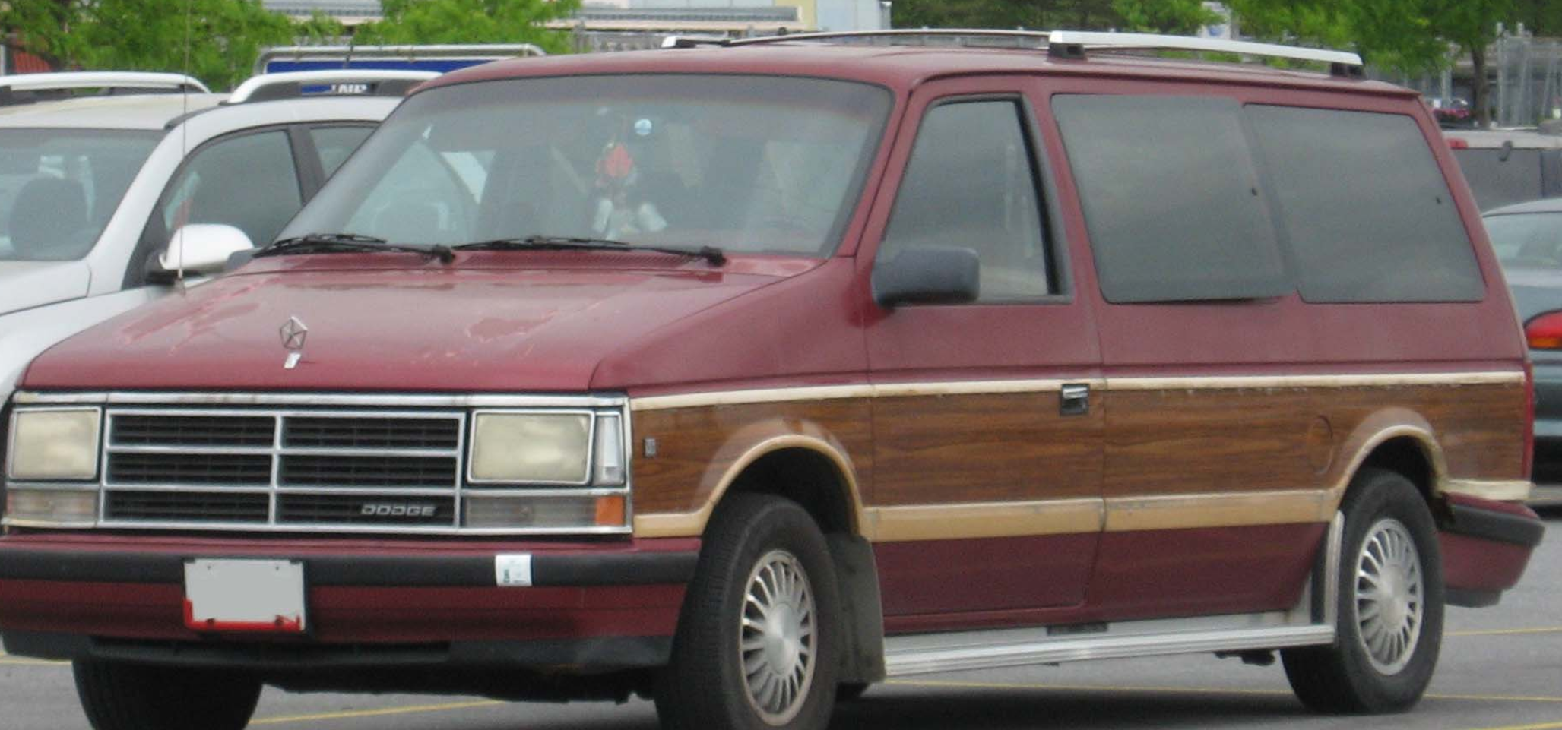
Lessons To Learn
Started with a $800 Caravan
Work done
V6 3.8L engine swap
New transmission
Power seats
Power windows
Tinted windows
Finished Product
$800 Caravan
Start with a quality foundation, more likely to have something of quality when done.

